Slide 1
Red Team Presents
Chris McCracken
Joshua Frazier
James Brown
Taylor Reid
Module 11.1.1 | Jul 15 2022
Bacchus Winery Reports Solution

Slide 2
Group Introduction and Case Briefing
Red Team has a diverse knowledge in the programing language and experiences of all variables. Collaborating with these attributes, our group chose the Bacchus Winery Case study based on the following:
Stan and Davis inherited ownership to the winery and needed to improve products and customer service in their new business methods.
Easier ways to track supply deliveries.
Reports on wines at regional distributors and tracking of conversions.
Labor reports for budgeting production and employee time.

Slide 3
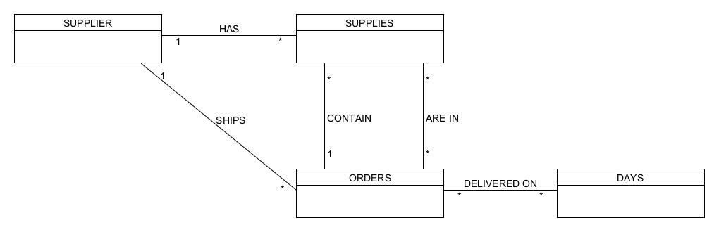
Group ORD:

Slide 4
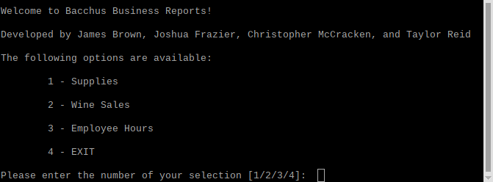
Business introduction and summary
Bachus Winery Case Study: The Bacchus’s are interested in a snapshot of the business to provide them the state of inventory, the distribution, and the employees. Solutions in reporting are as followed:
Supply Orders Report
Wine Sales Report
Employee Hours Report

Slide 5
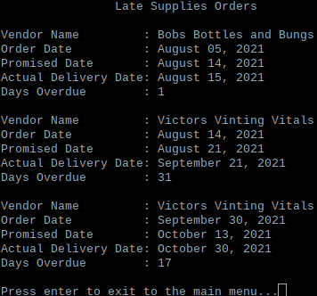
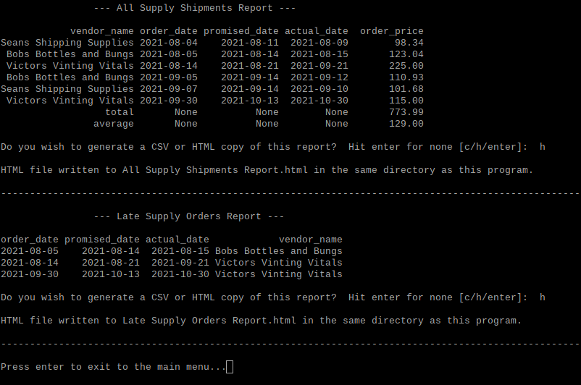
Late Deliveries Report
Late Deliveries report displays a month by month tracking of deliveries that were late and the time gap it took to be logged.
Assumption was made if the deliveries arrived on different dates and logged.

Slide 6
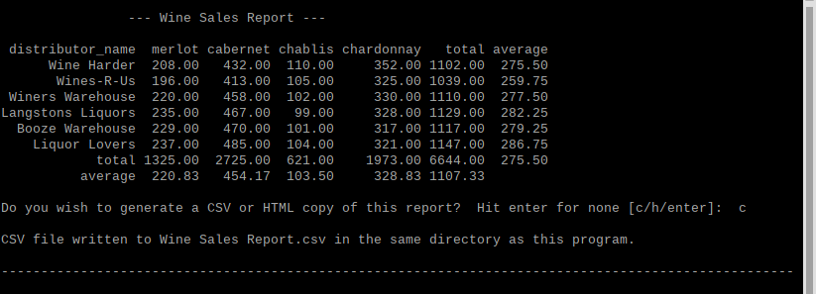
Wines Sold Report
Wines Sold report identifies the wines by type, which type the distributor carries, and how many were sold for focus.
Assumption made here is based on region and demand.

Slide 7
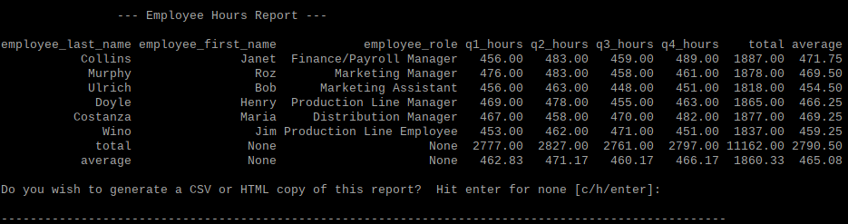
Hours Worked by Employees report
Hours Worked breaks down an employees credentials, role, and quarter on hours worked and provides a total for account budgeting.
Assumptions made were employees worked only one role and paid hourly per quarter.

